Slide 1
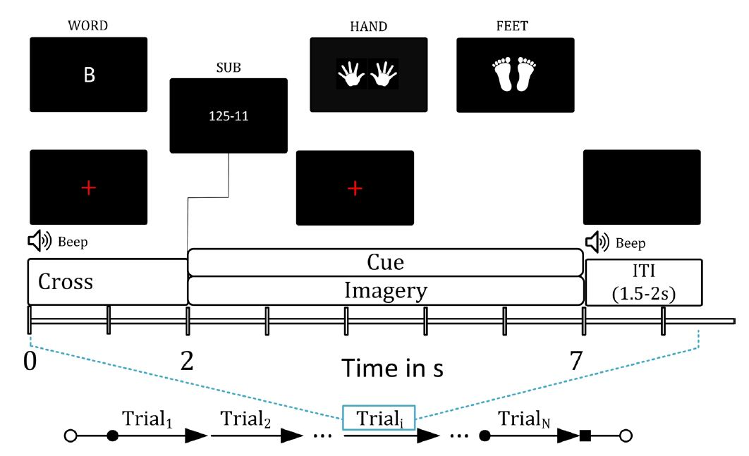
Project Descriptions
Dataset 1: MEG – MI and CI data
Full Dataset :
https://springernature.figshare.com/collections/A_magnetoencephalography_dataset_for_motor_and_cognitive_imagery_BCI/5101544
Project Dataset :
https://ulster-my.sharepoint.com/:f:/g/personal/samanta-k_ulster_ac_uk/EmjTyZPVZq5Fj_Qb2hSf__MB1pUPtFULpSsu8WgUmAoa1w?e=ECAluj

Slide 2
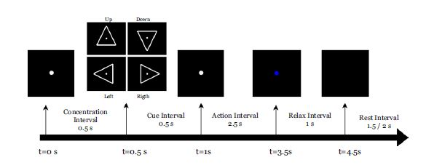
Project Descriptions
Dataset 2: EEG – Inner Speech
Full Dataset :
https://openneuro.org/datasets/ds003626/versions/2.1.2
Project Dataset :
https://ulster-my.sharepoint.com/:f:/g/personal/samanta-k_ulster_ac_uk/EmjTyZPVZq5Fj_Qb2hSf__MB1pUPtFULpSsu8WgUmAoa1w?e=ECAluj

Slide 3
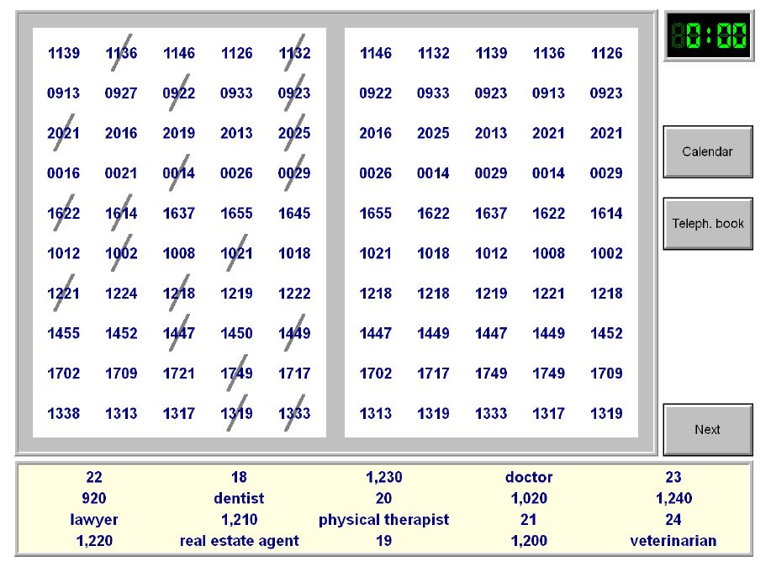
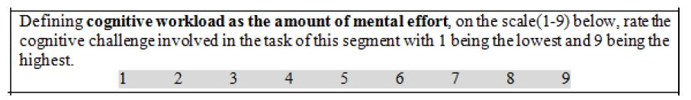
Project Descriptions
Dataset 2: EEG – Mental Workload
Full Dataset :
https://ieee-dataport.org/open-access/stew-simultaneous-task-eeg-workload-dataset
Project Dataset :
https://ulster-my.sharepoint.com/:f:/g/personal/samanta-k_ulster_ac_uk/EmjTyZPVZq5Fj_Qb2hSf__MB1pUPtFULpSsu8WgUmAoa1w?e=ECAluj

Slide 4
Project Descriptions
Task 1: Classification Models
What you need
to produce
What you have
What you need to build
Raw Data
?
Predicted Label
Some suggestions (but not limited to):
Advanced signal processing techniques
ML Classifiers
Deep learning models (e.g., CNN, GNN, LSTM, Vision Transformer, etc.)

Slide 5
Project Descriptions
Task 2: Data Augmentation
What you need
to produce
What you have
What you need to build
Raw Data
?
New synthetic data
Some suggestions (but not limited to):
Deep learning models: GAN, VAE, LSTM etc.

Slide 6
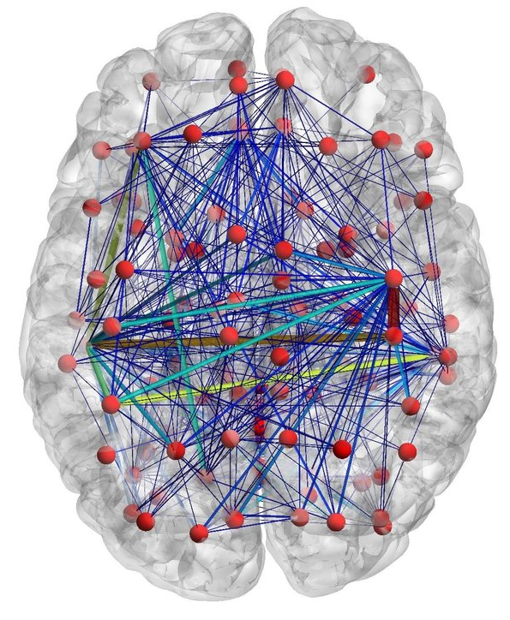
Project Descriptions
Task 3: Brain Connectivity
What you need
to produce
What you have
What you need to build
Raw Data
Neuroscientific Insight
Some suggestions (but not limited to):
Functional connections: PLI, PLV, CORR, COH etc.
Effective Connectivity: DCM, Granger Causality etc.

